Slide 1
King County International Airport
Taxiway B Relocation Project
John Parrott, King County International Airport Director

Slide 2
The Compliance Gap | The Safety Objective | Proposed Action
Current Standard: The FAA requires a 400-foot separation for Airplane Design Group (ADG) IV to ensure safe simultaneous operations. | Achieving the 400-foot standard minimizes the risk of incidents or incursions when multiple ADG IV aircraft are operating. | Relocation: Shift Taxiway B and its Taxiway Object Free Area (TOFA) west by 50 to 75 feet.
Existing Condition: Runway 14R-32L and Taxiway B currently range from 325 to 350 feet. |  | Infrastructure: Existing landside infrastructure must also be relocated to accommodate the shift.
Total Deficiency: The separation is currently short by 50 to 75 feet.

Slide 3
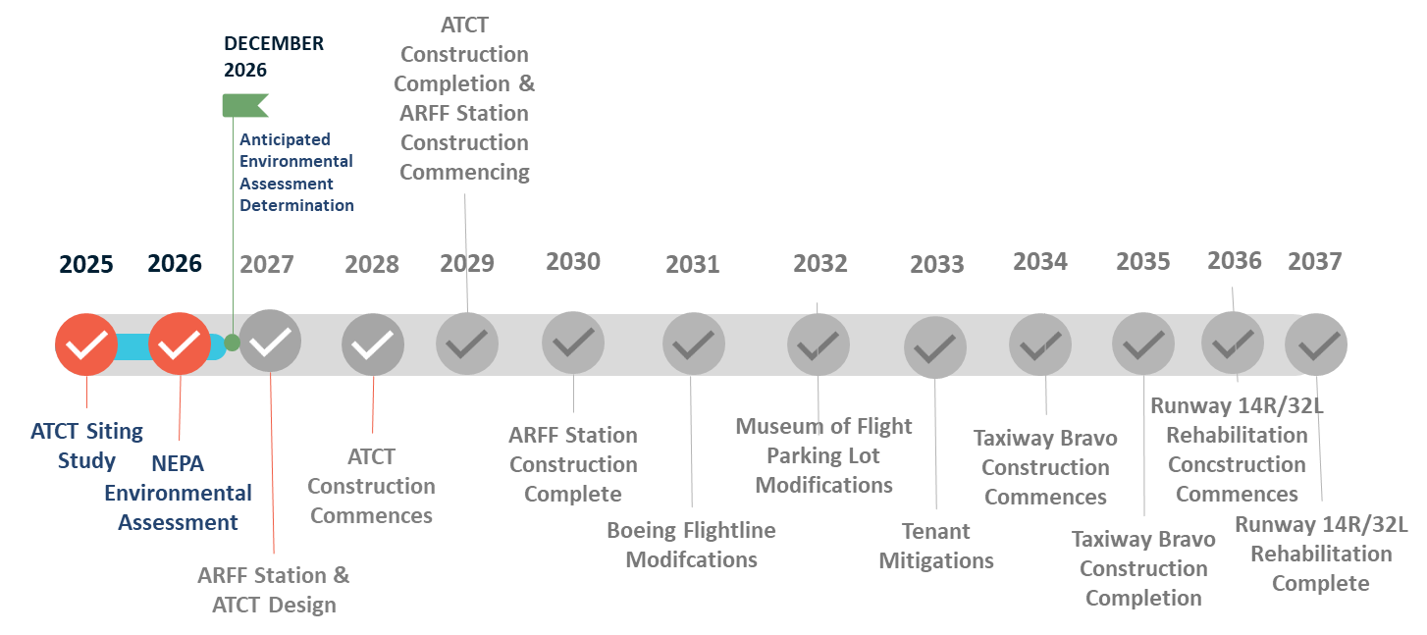
Project Timeframe

Slide 4
Project Financials
FAA has committed ~500 million in funding
KCIA will fund the 10% match through:
Revenues generated at the airport
Landing/parking fees
Ground leases
Fuel Flowage fees
Bond Funding

Slide 5
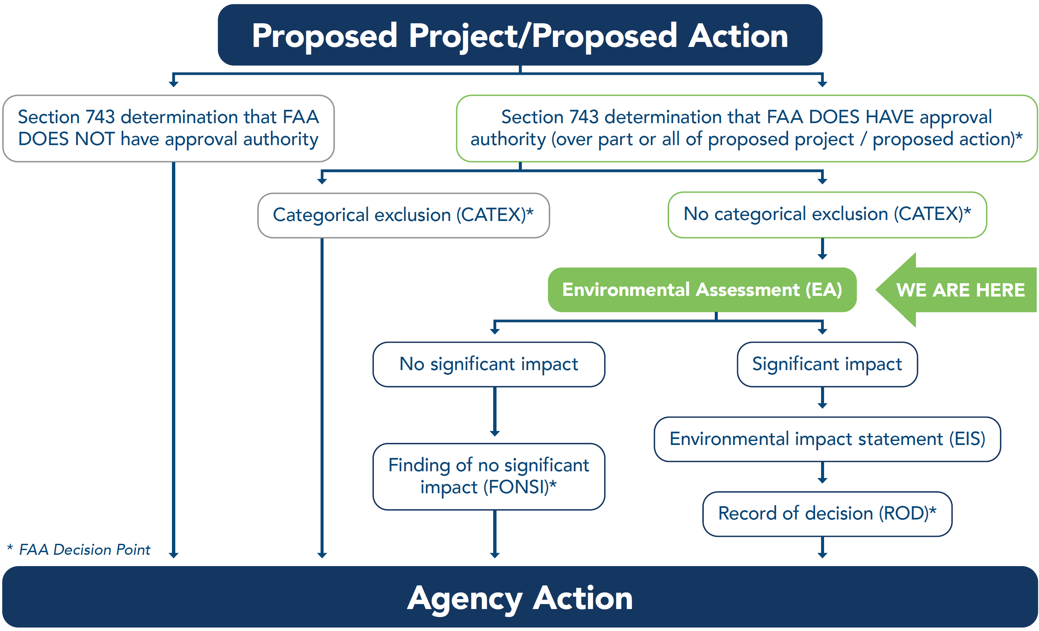
The NEPA Process

Slide 6
Questions?

