Slide 1
King County 2027 Sewer Rate Proposal
Regional Water Quality Committee Meeting
May 6, 2026

Slide 2
Key Takeaways
Executive's 2027 rate proposal maintains:
  12.75% rate increase forecast last year
  Regulatory compliance
  High priority investments in asset renewal and replacement and capacity projects
Alternative scenarios that shift project timing were considered
  Deferred asset renewal/replacement and capacity projects would add risk with modest, near-term rate reductions and higher long-term costs
Review of regulatory requirements
  Combined Sewer Overflow (CSO) consent decree, National Pollutant Discharge Elimination System (NPDES) permit, nutrient regulations
  Evaluating tools under Clean Water Act, meeting with regulators
  Requires successful negotiations, process may take some time
WTD continuing to undertake variety of cost containment efforts
2

Slide 3
Sewer Rate and Capital Work Plan
Third-party independent review of WTD’s capital program to begin Q3 2026, King County Auditor’s Office is project manager
Incorporating affordability policy options and metrics into Regional Wastewater Services Plan Update
Advocating for federal support for investments in Puget Sound
Building on 2025 Utility Rate Summit and collaborating with RWQC members to develop next steps

Slide 4
Sewer Rate and Capital Work Plan continued
Two MWPAAC representatives will attend select WTD capital portfolio management meetings
Provided rate briefings for MWPAAC, City of Pacific, Seattle Public Utilities’ Customer Review Panel, and City of Bellevue (scheduled)
Multi-year rate proposal for 2028-2029 will provide a longer timeline and further improved engagement and predictability in the rate development process

Slide 5
Conclusion with logo

Slide 6
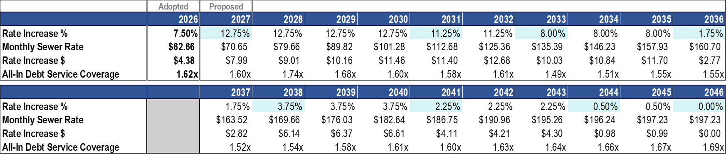
Executive’s Proposed 2027 Rate and 10-Year Forecast
Maintains the same rate for 2027 as forecasted last year: 12.75% increase to $70.65 monthly
Prioritizes regulatory compliance and critical, high-risk asset management projects, and assumes deferral of low-to-mid risk projects
  Assumes completion of Combined Sewer Overflow (CSO) Consent Decree projects by 2037
  Provides operational and staffing funding to support prioritized capital projects and ongoing operational and maintenance costs
Continues the cash-funding approach based on depreciation with an average 27% cash funding of the Capital Improvement Program over 10-year forecast period
6

Slide 7
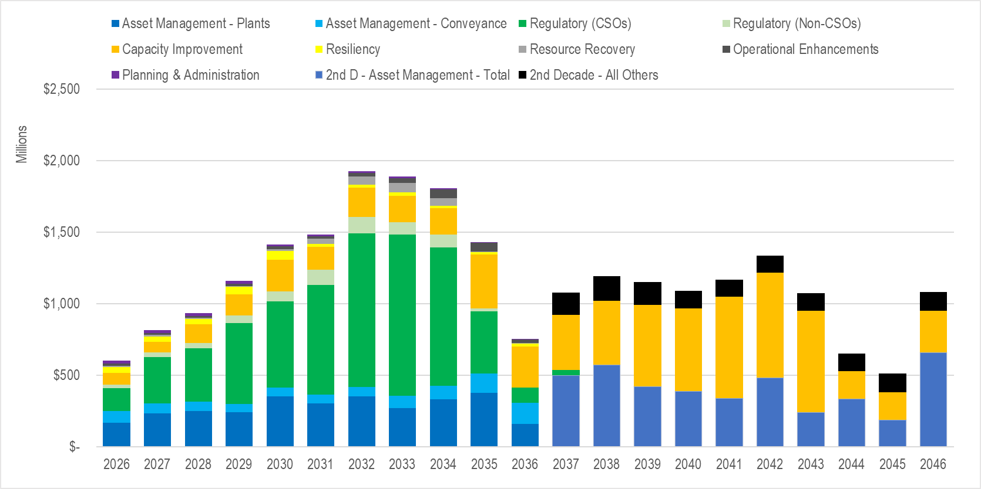
20-Year Rate Capital Forecast by Portfolio Category
1st Decade (‘26-’36): $14.2B
2nd Decade (‘37-’46): $10.3B
Known Unknowns, e.g.:
Nutrient regulations and costs
Contaminants of emerging concern
Other CSO cost updates
Significant uncertainty
7

Slide 8
2027 Sewer Rate Process Calendar
Agency | Date | Briefing
Executive Budget Office | 1/29/2026 | 2027 WTD Preliminary Sewer Rate Proposal
Regional Water Quality Committee (RWQC) | 2/4/2026 | 2027 WTD Preliminary Sewer Rate Proposal
MWPAAC Rates & Finance (R&F) Subcommittee | 2/5/2026 | 2027 WTD Preliminary Sewer Rate Proposal
MWPAAC General meeting | 2/25/2026 | 2027 WTD Preliminary Sewer Rate Proposal
Executive Team | 2/26/2026 | 2027 WTD Sewer Rate Proposal
RWQC | 3/4/2026 | 2027 WTD Sewer Rate Proposal
MWPAAC R&F | 3/5/2026 | 2027 WTD Sewer Rate Proposal
Executive | 3/19/2026 | 2027 WTD Sewer Rate Proposal
MWPAAC General Meering | 3/25/2026 | 2027 WTD Sewer Rate Proposal
Executive | 3/26/2026 | Tech Memo due to the Executive
RWQC | 4/1/2026 | Discussion on potential letter on sewer rate
County Council | 4/23/2026 | Executive transmitted 2027 Rate Proposal to Council
MWPAAC General Meeting | 4/29/2026 | Action on potential letter to KC Council
RWQC | 5/6/2026 | Briefing
RWQC | 6/4/2026 | Briefing
Budget and Fiscal Management (BFM) Committee | May 2026 | Tentatively on May 13 and May 27 BFM agendas
County Council Approval Required by | 7/1/2026
8

Slide 9
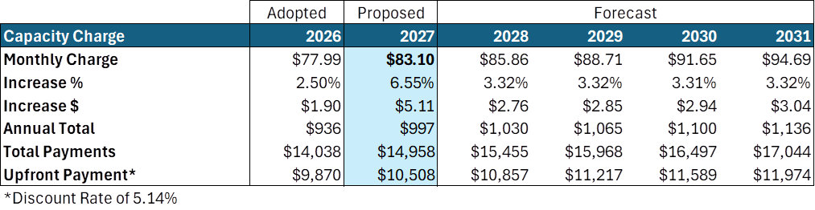
Capacity Charge
WTD’s rate consultant (Raftelis) recalculated the capacity charge based on industry standard methodology for 2027
Legislation (Proposed Ordinance 2026-0066) to implement the updated methodology is pending at King County Council
New methodology would allow for indexing capacity charge to Construction Cost Index (CCI)
Will update after RWSP process results in new capital plans
9

