Slide 1
Public Defense Standards for Indigent Defense
King County Council Law and Justice Committee | May 6, 2026
Kapena Pflum, Executive Office Budget Team

Slide 2
Value of Clarity
Challenging to budget, plan, negotiate when unclear which standards to follow
Significant budget, operational, and labor implications if King County code not clarified

Slide 3
Executive Office Position
Washington State Supreme Court rules, orders, standards for indigent defense should take precedence over WSBA guidance.
  Caseload standards and timelines
WSBA standards not covered by Supreme Court rules should be guidance, not requirement, particularly standards with significant budgetary implications.
  Professional support staff ratios

Slide 4
Budget Implications

Slide 5
Budget Scenarios
Timeline for Implementation – 10 years vs. 3 years
Professional Support Staff Ratios – Old/historical vs. New WSBA

Slide 6
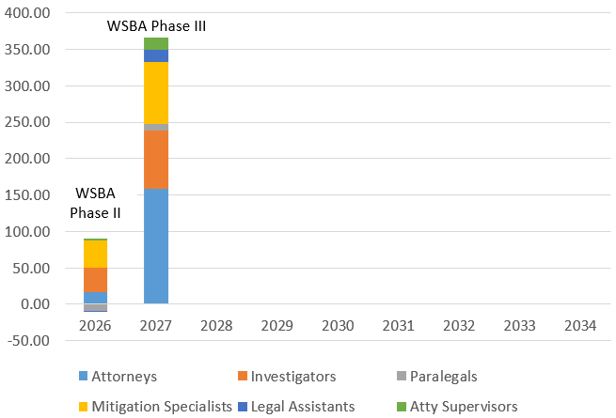
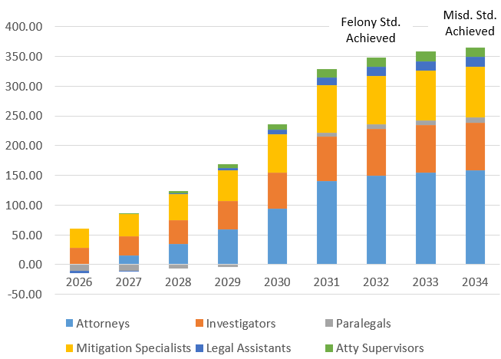
Additional Positions – Timeline Comparison
WSBA 3-year Timeline
Supreme Court 10-year Timeline
Add over 360 FTEs and $60M in personnel costs by mid-2027
Add about 75 positions (15 attorneys) and $13M in personnel costs in 2027

Slide 7
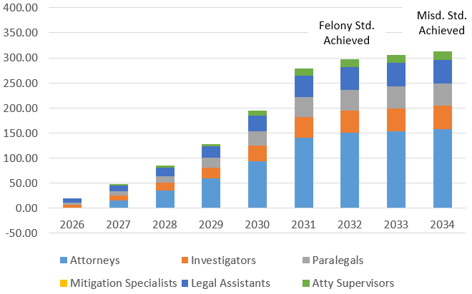
Additional Positions – Old vs New Professional Support Staff Ratios
Old WSBA Ratios
(Historically Used by KC)
New WSBA Ratios
Over 310 FTEs and $63M in personnel costs by 2034
About 45 positions (15 attorneys) and $7M in personnel costs in 2027
Over 360 FTEs and $77M in 2034
About 75 positions (15 attorneys) and $13M in personnel costs in 2027

