Slide 1
Americans with Disabilities Act Compliance & Disability Equity in King County
Darya Farivar, Cecelia Black, and Nate Olsen
ADA and Disability Equity Specialists

Slide 2
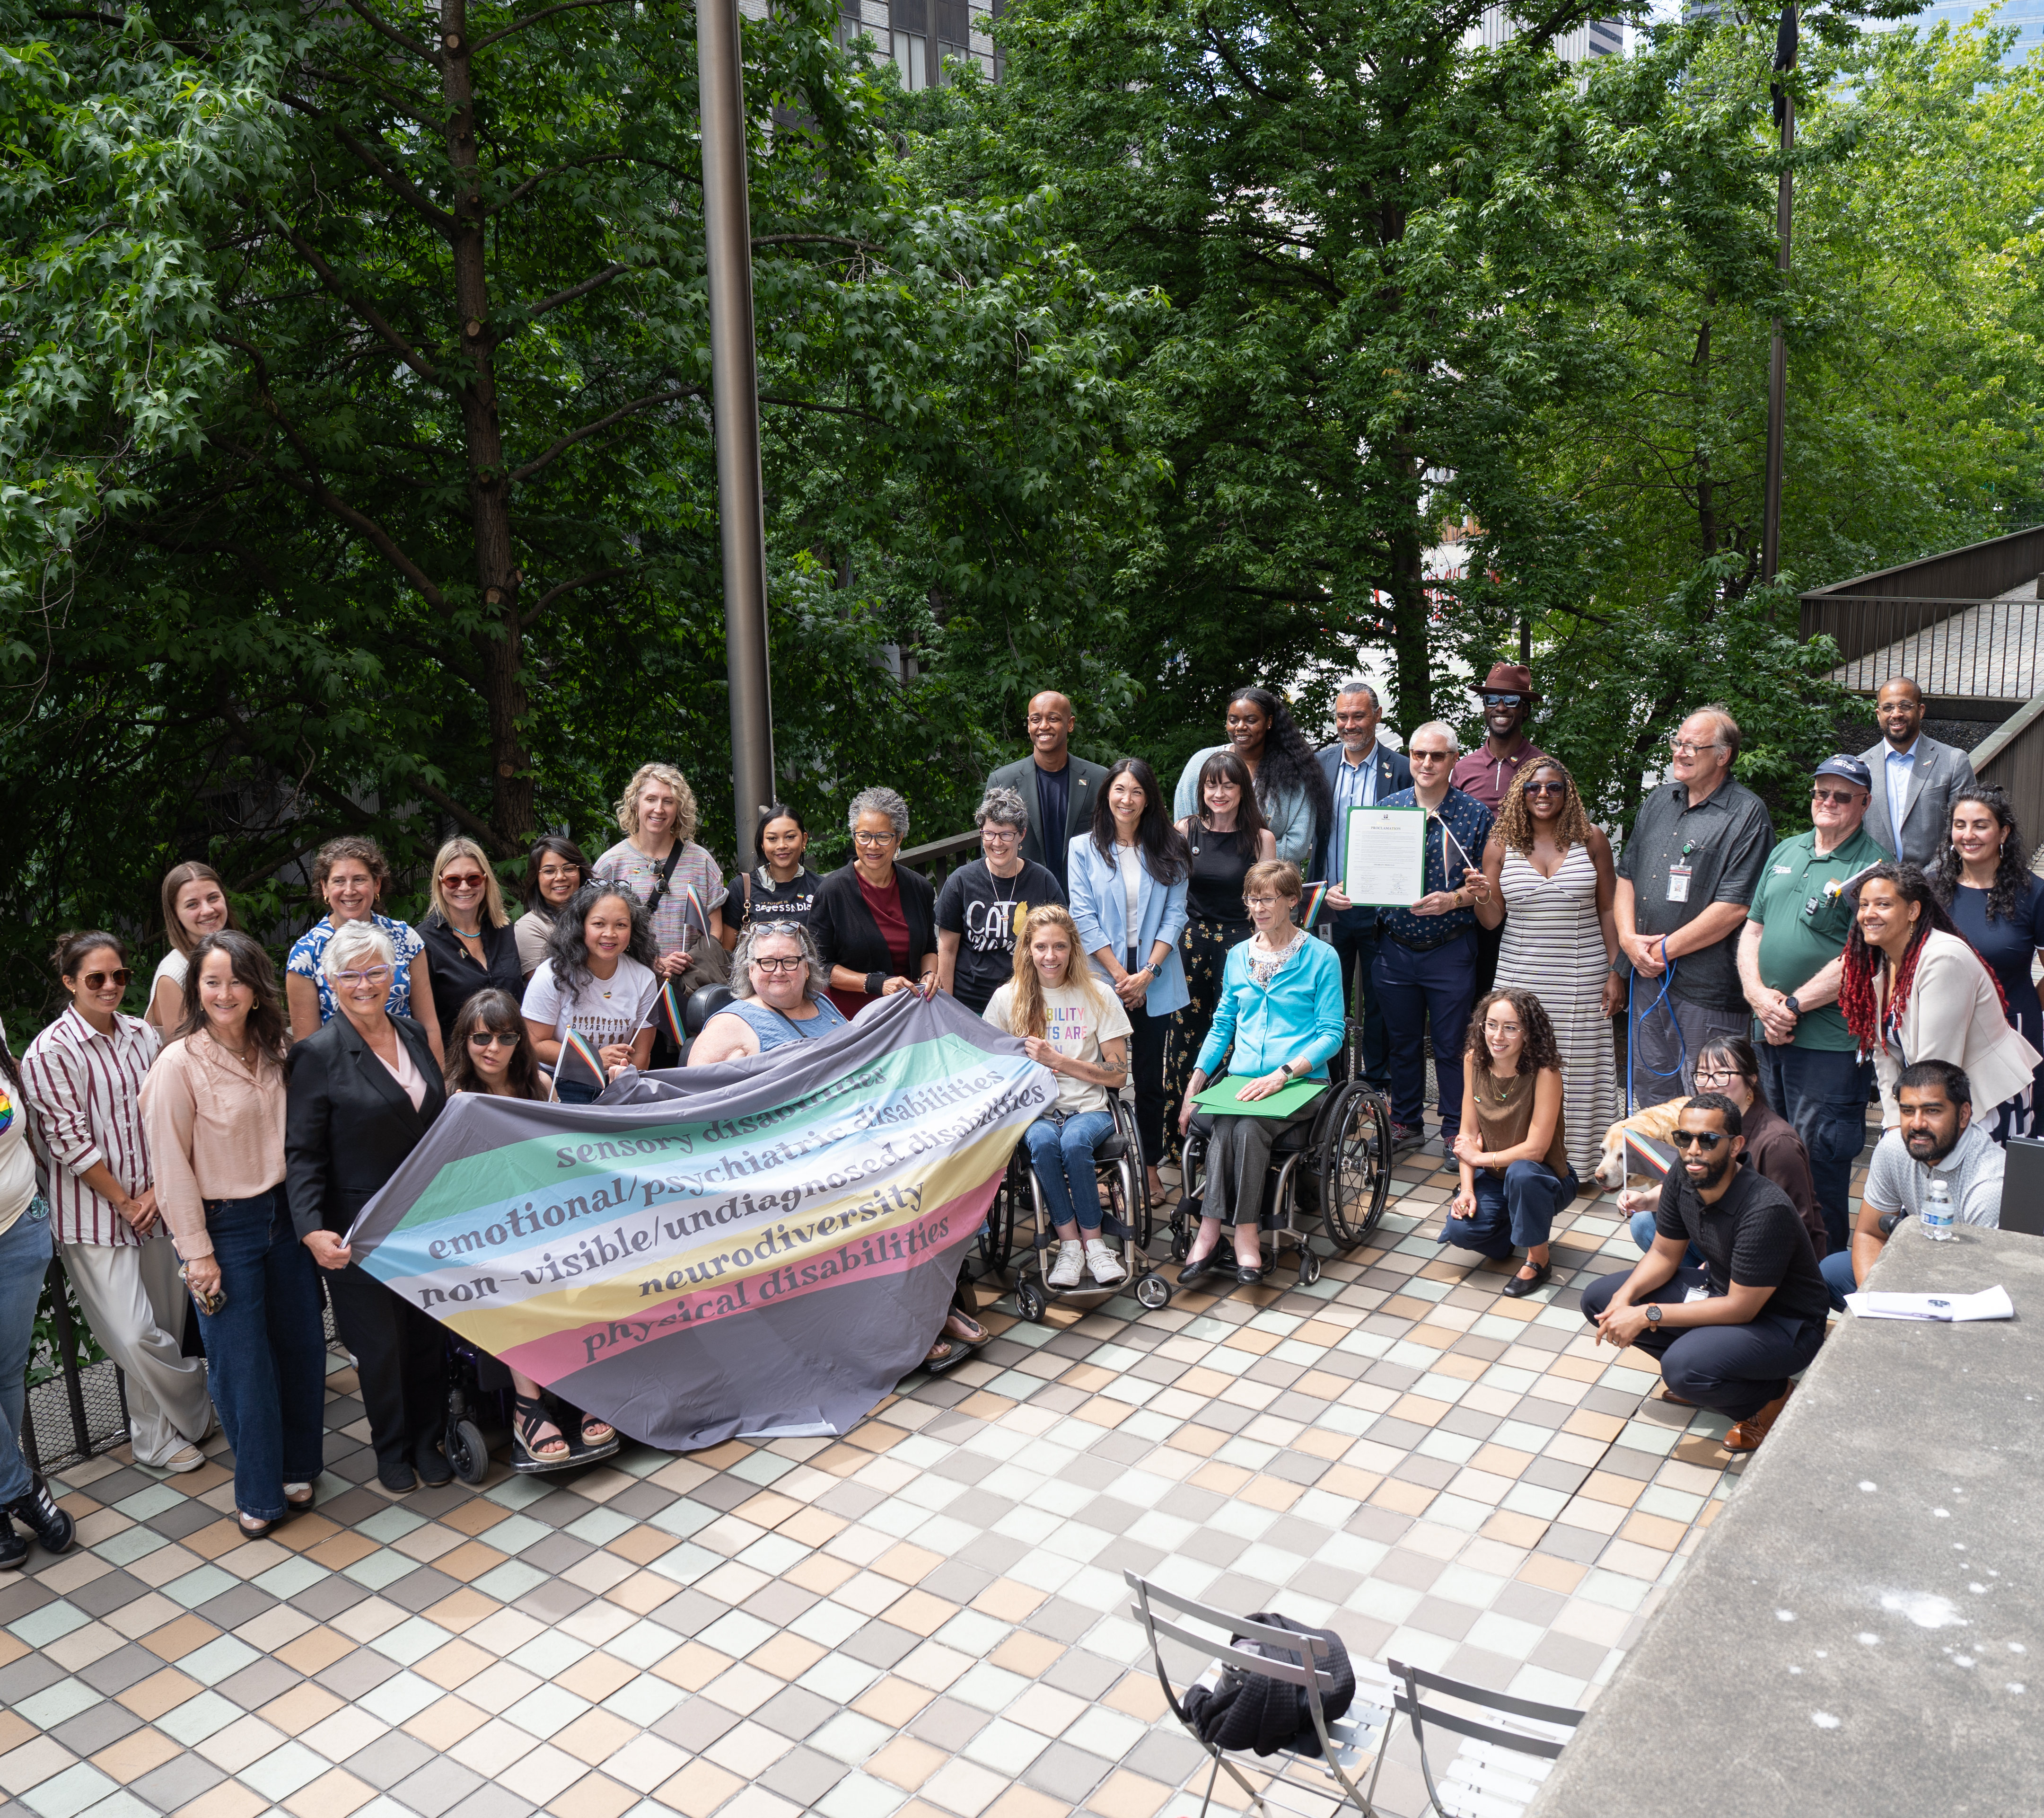
Happy Disability Pride Month!
July 26th, 1990 Americans with Disabilities Act Bill Signed
Celebrate disability identity and community, recognizes disability culture and leadership
Ground ourselves in the lived experiences of people with disabilities
Recommit to confronting ableism, combatting stigma, and building a culture of inclusion at King County

Slide 3
About Us
Program established in 2022 after receiving a report from the community: "Still Left Out: 30 Years After the ADA"
Develop Countywide accessibility plans and policies;
Provide guidance and support to departments trying to achieve or maintain ADA compliance;
Help members of the public seeking accommodations connect with the appropriate individual;
Centralize compliance and equity resources;
Assist the Executive in identifying challenges, adapting systems, and establishing accountability mechanisms.

Slide 4
Disability Data Summarized
From Communities Count 2018-2022 data
20% of adults in King County have a disability
22% Female, 20% Male, 47% Transgender
42% AI/AN, 29% NHPI, 27% Hispanic, 26% Black, 21% White, 12% Asian
33% Veterans, 20% non-veteran
52% <$20,000 household income
23% South, 20% North, 19% Seattle, 17% East

Slide 5
Guiding Laws and Regulations
Americans with Disabilities Act Title I & II
  Requirements to be accessible for members of the public and provide reasonable accommodations for employees
Web Content Accessibility Guidelines 2.1 A/AA
  Requirements to be digitally accessible
  Large focus on this in 2026
KCC 2.16.025 County executive
  Support departments in ADA compliance

Slide 6
Current State of ADA Compliance
Expired Title II policy (2003 - 08)
Title I process improvements
Completed Transition Plans
  Metro
  DLS Roads Division
In Progress Transition Plans
  RALS
  DNRP WTD and Parks Division
  Elections
  DAJD
Departments who have an established process/coordinator
DPD (coordinator)
DAJD (both)
DJA (both)
KCSC (both)
PHSKC (both)
Metro (both)
DHR (both)
DLS (coordinator)

Slide 7
Current State of ADA Digital Compliance
ADA Title II requires King County's digital content to be accessible
Web Content Accessibility Guidelines (WCAG 2.1 A/AA) deadline April 26, 2027
No audit to understand state of digital compliance
Compliance is inconsistent across the County
KCIT has updated Kingcounty.gov platform to comply with WCAG 2.1
King County has digital accessibility champions in most departments

Slide 8
Current ADA Digital Compliance Projects
KCIT Digital Compliance Remediation Capitol Project
Department leaders: DNRP & Metro
DLS has created a WCAG workgroup
The Executive is working on a digital accessibility policy to set compliance standards and outline department roles and responsibilities

Slide 9
Other Projects
In addition to the digital accessibility projects...
Disability Pride Month festivities – Thank you for joining us!
Establish a Disability Equity Commission (update KCC 2.55)
Establish an internal Title II Resource Hub
Update our Title II policy
Standardize the reasonable accommodation process

Slide 10
Thank you &
Happy Disability Pride Month!
Contact Darya, Nate, and Cecelia at: KCADA@kingcounty.gov

