Slide 1

King County Board of Health Briefing
May 21, 2026
Addressing Barriers to Massage Licensure for Asian Workers
Presented by: MPOP
(Massage Parlor Organizing Project)
Inaccessibility in Massage Licensing Exams as Risk Factor for Exploitation

Slide 2
King County Board of Health Briefing
May 21, 2026
AGENDA
01 | Introduction
02 | Framing the Issue: From Anti-Trafficking Approach to Labor Approach
03 | Inaccessibility in Massage Licensure
04 | Solutions
Presented by MPOP

Slide 3
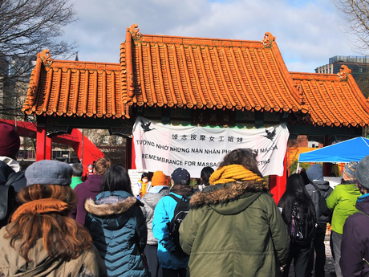

King County Board of Health Briefing
May 21, 2026
01. INTRO: WHO IS MPOP
We are a grassroots organization based in the Chinatown-ID that supports the needs of migrant Chinese massage workers.
Presented by MPOP

Slide 4
MPOP is an immigrant workers’ rights organization.
We support the safety of all workers.
We oppose all forms of trafficking & forced labor.
We believe in the need to address conditions that make people vulnerable to exploitation and forced labor.
We believe in labor protections and workers’ power as protective factors against trafficking and exploitation.
Raids in all forms, increase the vulnerability of immigrant workers.

Slide 5
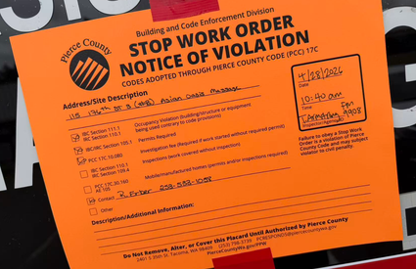

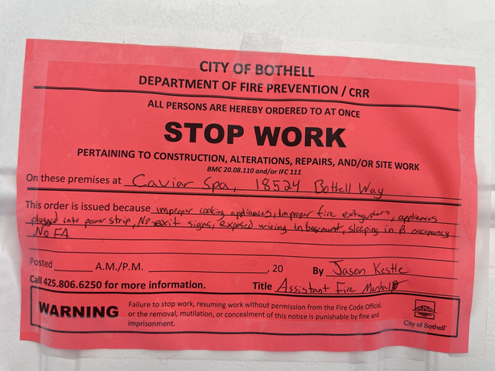
Raids Timeline
FIFA (6/15-7/6) Risks: police sweeps, ICE presence justified by “anti-trafficking” prevention
2018-2019 CID
  6 arrested
  Owner charged with: $ laundering，promoting prostitution
  26 workers questioned by police
  Police narrative：“Rescued 26 women”
April 2026
Oregon
April 28, 2026 Tacoma
May 6, 2026 Kirkland, Bellevue
  at least 45 Asian parlors shut down by fire dept
Jan 2026
Everret and Marysville
  20 parlors inspected by police, 3 raided
July 2025
Yakima
May 2023
White Center
Feb 2026
Shoreline
  5 Asian parlors violently raided by police + fire dept. for “potential trafficking”
  1 owner arrested，released the next day（insufficient evidence),
  at least 3 workers lost jobs
April 14, 2026 Bothell
6 arrested
Feb 2025 Kennewick
Notes:
Fire Dept (Civil Enforcement) & Police collaboration
data exchange
eroding trust in public health
Eg of worker who had parlor shut down for “lack of running water” bc pipe was getting fixed, even though they were currently implementing fire code compliant changes
this is your current policy

Slide 6
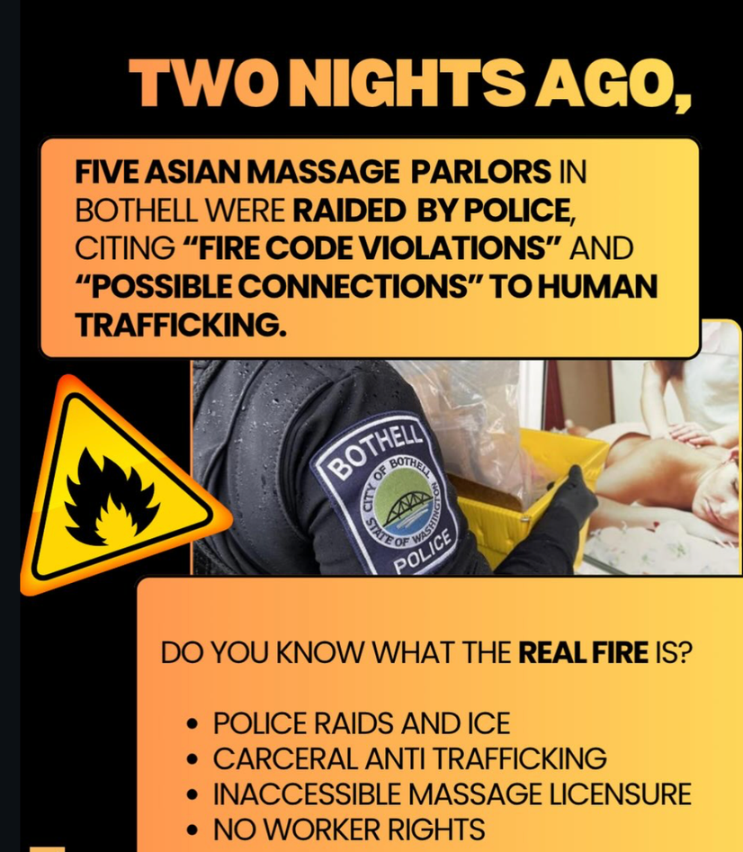
King County Board of Health Briefing
May 21, 2026
02. FRAMING THE ISSUE: WORKERS RIGHTS AS PROTECTIVE FACTORS
Presented by MPOP

Slide 7
King County Board of Health Briefing
May 21, 2026
TERMS & DEFINITIONS
Trafficking
Exploitation
Sex Work
Unlicensed Massage
Worker’s Rights & Labor Protections
Presented by MPOP

Slide 8
King County Board of Health Briefing
May 21, 2026
‘Illicit Massage’: Conflating Trafficking, Sex Work, and Unlicensed Massage
Trafficking
Sex Work
Unlicensed Massage
  carceral law-enforcement led anti-trafficking
⟶ increased vulnerability of workers to labor exploitation due to fears of criminalization
  criminalizing aspects of sex work
  sting operations
  prostitution charges vs. trafficking
  used as ‘evidence’ of trafficking
⟶ disregards the systemic barriers to massage licensure for non-English-speaking workers
Carceral approaches exacerbate risks of crimmigration
Presented by MPOP

Slide 9
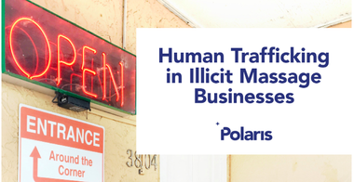

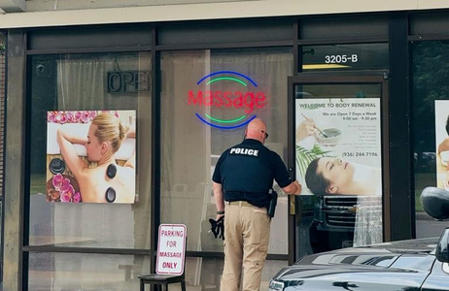
King County Board of Health Briefing
May 21, 2026
Unlicensed workers confronted with potential of criminalization vs rescue binary
(unlicensed conflated with sex work vs trafficking victims)
LABOR, WORKERS’ RIGHTS ISSUE
Address root causes
Centers worker autonomy
Anti-carceral approach
Preventative framework better serves both autonomous workers & potential trafficking survivors
Framework Shift
This binary drives workers deeper into precarious work/living conditions that increase their vulnerability to exploitation
Presented by MPOP
Notes:
unlicensed workers are classified as either sex workers or trafficking victims
Unlicensed workers are forced into the criminalization vs rescue binary
trafficking language is used to conflate all unlicensed massage workers and trafficking victims
viewing unlicensed workers as illegitimate workers when they're not being trafficked
criminalization doesnt serve any of these groups (unlicensed workers, or trafficking victims)
how this reframe serve both people who are trafficking victims, and people who are autonomous workers

Slide 10
King County Board of Health Briefing
May 21, 2026
03. INACCESSIBILITY IN MASSAGE LICENSURE
BARRIERS
IMPACTS
  Lack of language accommodations (licensure exam, training schools)
  Vulnerability to scams
  Cost: $13-17K tuition, 625+ hours
Criminalization
Economic Hardship, Deportation
Unsafe working conditions
Exposure to trafficking, labor exploitation
Barriers to autonomy, safety, & health
Presented by MPOP

Slide 11
King County Board of Health Briefing
May 21, 2026
04. SOLUTIONS
ALTERNATIVE CERTIFICATION AS PUBLIC HEALTH STRATEGY
ADDRESSING EXISTING INEQUITIES IN MASSAGE LICENSURE PROCESS
  Recreational body work, relaxation & wellness practice
  Precedents:
    Birth doula licensing (ESHB 1881)
    successful completion of congruent ancestral practices
    alternatives to demonstrating competencies for licensing, eg. massage workers’ years of experience and client testimony
  Other states have alternative licensure for body work
  language access for exams
  scholarships for training schools
Presented by MPOP

Slide 12
King County Board of Health Briefing
May 21, 2026
THANK YOU.
@mpop_sea
info@mpopsea.org
www.mpopsea.org
Presented by MPOP

